Slide 1
Welcome to Lilleshall Primary School
This presentation is full of information to help you get ready for your child’s start at school in September.

Slide 2
The Induction Process
Parents Meeting – Mrs Savill will talk to as many parents as possible. If you do not get a chance to talk and you feel you need to before our after school visits then please telephone school to arrange a call.
On the school website you will find a virtual tour made especially for the new Year R intake showing them how to come into school and the classroom.
At the after school meeting your child will receive a booklet that you and your child can read to help them get to know the teachers and classroom.
In September children have a staggered start, completing half days for a week so that they can meet us and we will spend time getting to know them.
If possible you will be invited to have lunch with your child during this time.
We will hold a meeting with parents early in the Autumn term to talk about the curriculum and how you can support at home.

Slide 3
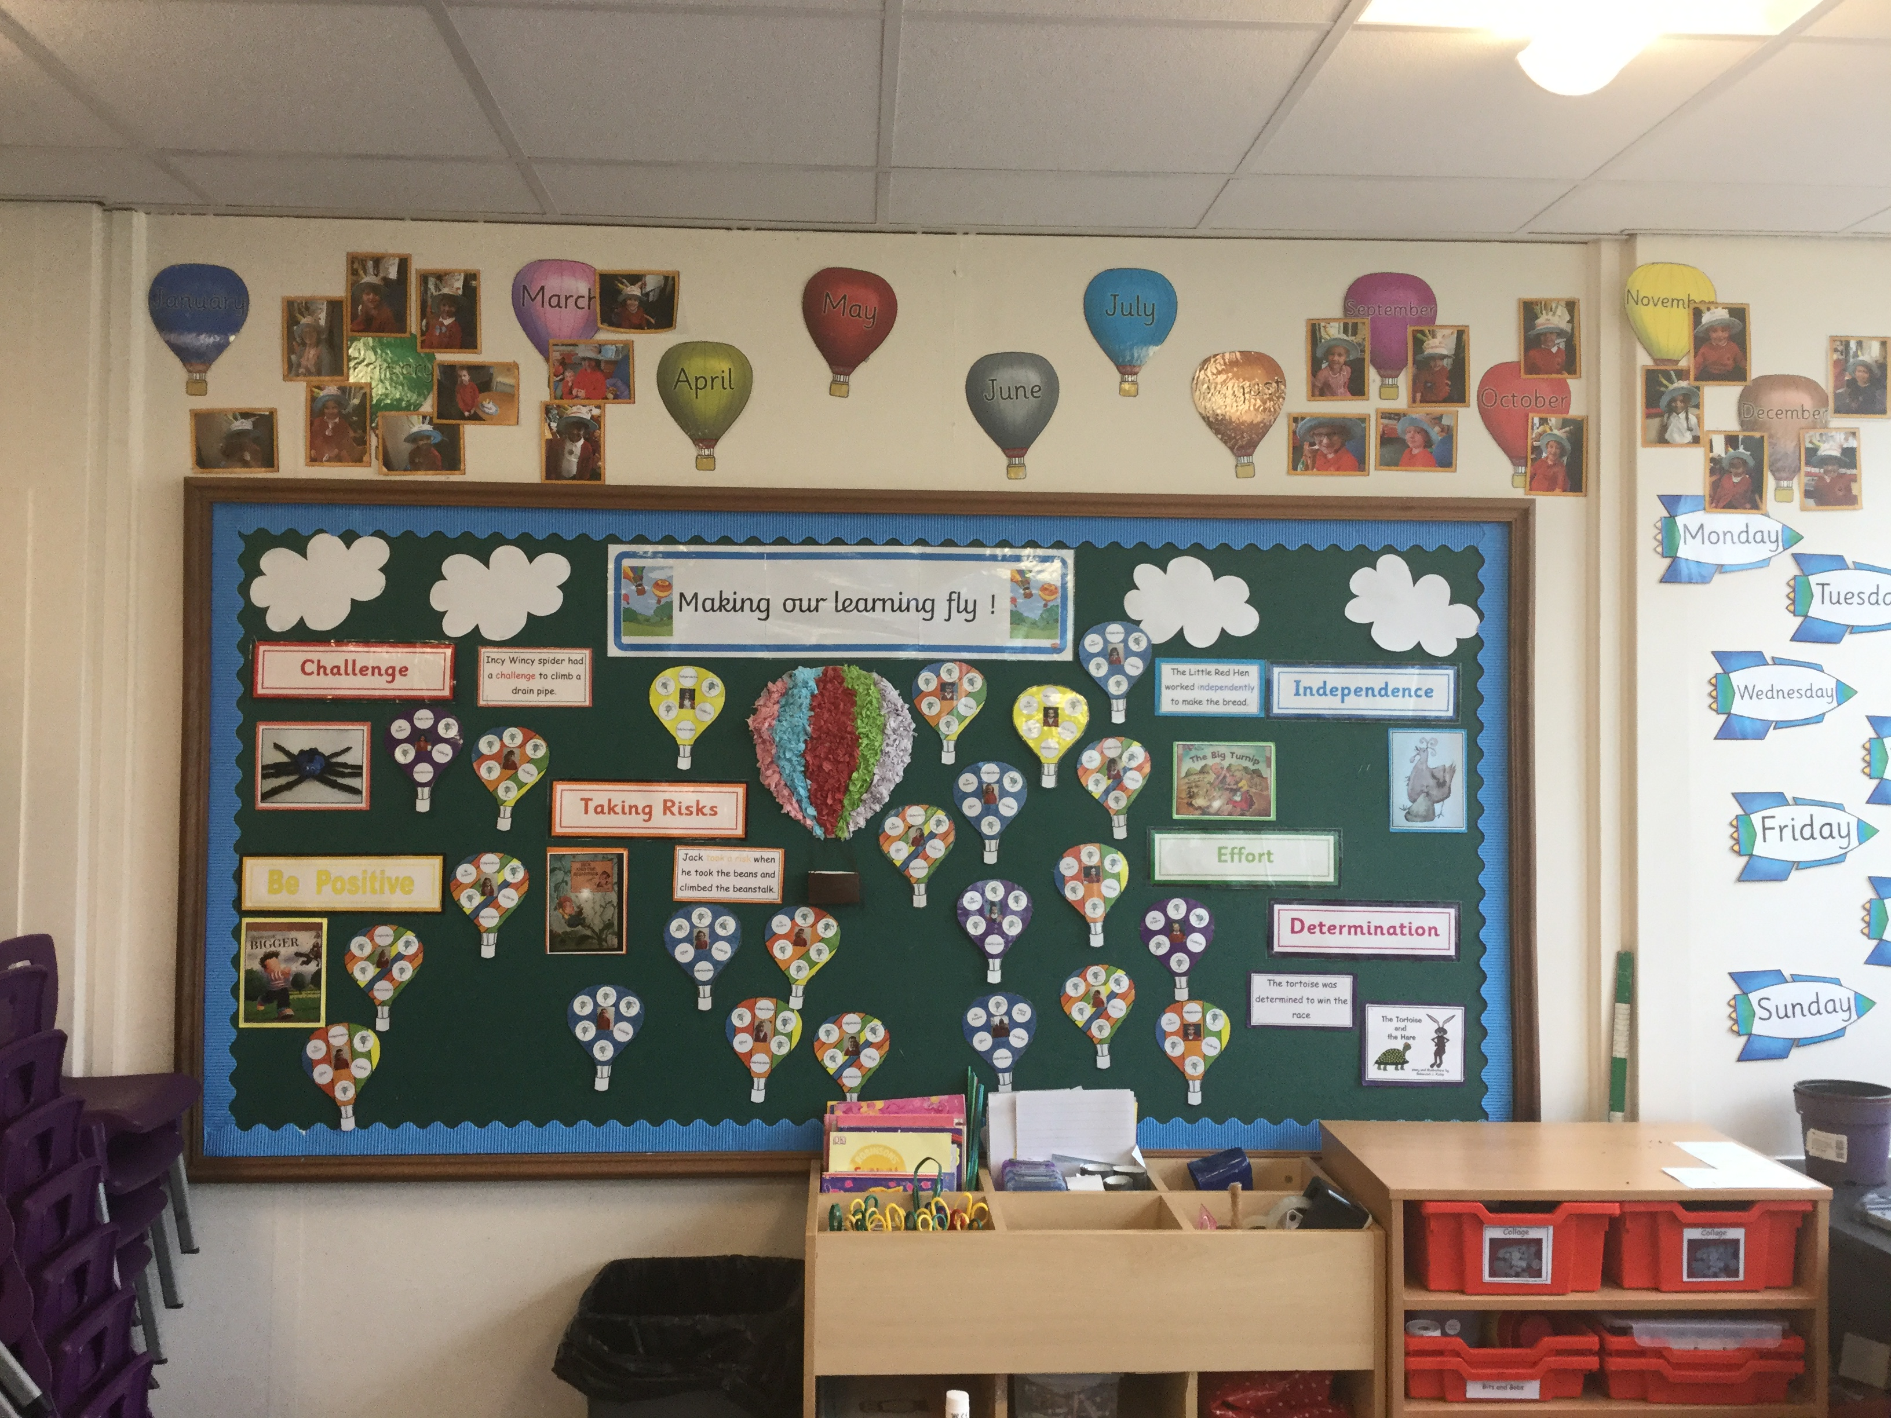
Making Our Leaning Fly
At school we spend time developing understanding and motivation for learning so that we can make every child’s learning fly.
We teach the children the following words and enable them to use them as they talk about their learning…
Challenge
Independence
Taking a risk
Determination
Effort
Being Positive

Slide 4
Behaviour Code
At Lilleshall Primary we have high expectations of behaviour and invest time in helping your child learn how to become a happy member of our community.
We celebrate behaviour with a positive approach using house points and celebrating success certificates.
We have a strong policy which all members of staff follow to help children learn our behaviour expectations including – reminders, warnings and timeout.
We employ an extra member of staff to help children develop social skills and play games at lunchtimes.

Slide 5
School Dinners
Children in Reception and Key stage 1 classes are entitled to a free school lunch every day.
This will be either a hot dinner or a sandwich or wrap.
Children may bring a packed lunch from home if they prefer.
The menu for School Lunches is set by the Local Authority and is available to help you decide if your child would like a school lunch.
You may decide on a daily basis whether your child would like a school hot or cold dinner or whether you bring in a packed lunch. It does not have to be the same every day.
The children will be asked each day what they would like, in terms of a hot dinner or sandwich or home packed lunch. If you would prefer to make the choice for them you can send in a message to school indicating your preference on a daily or weekly basis.

Slide 6
Wrap Around Care
Lilleshall has a club that caters for children in school needing to start before or after regular school hours.
This is run by school and many members of staff at also work in school as Teaching Assistants.
It is situated in the school building.
In the pack that you have received there is a leaflet you can use to contact us to reserve a place for your child.
School also offers opportunities to join clubs that run after school.

Slide 7
School Nurse
There is a school nurse assigned to Lilleshall school and we can contact them at any time during the year to discuss any issues that you are having.
Common issues include – toileting, sleep, allergies etc.
Please see further details of this service:
https://www.shropscommunityhealth.nhs.uk/school-nurses-telford
The school nurses have produced a starting school video which can be found on YouTube – please find the link below:
https://www.youtube.com/watch?v=ArlteeIJY00&list=PLkxadu_CuP_1UPA3Snp2uJ6wa1qETwOXJ&index=7

Slide 8
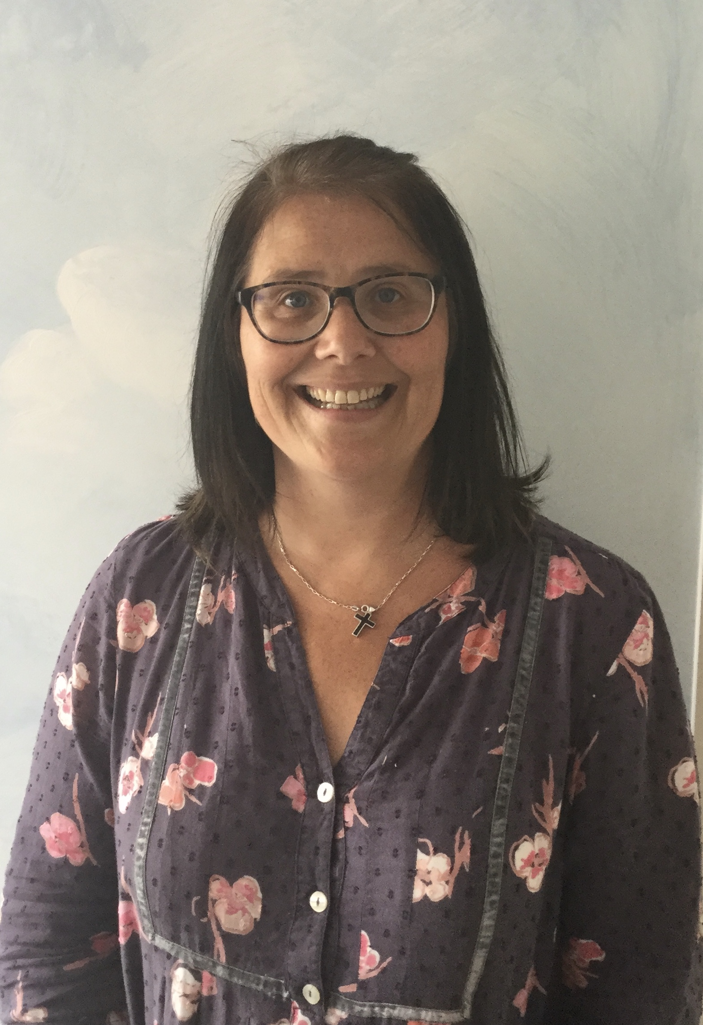
Your Teacher
Mrs Savill will be your full time teacher in Year R.

Slide 9
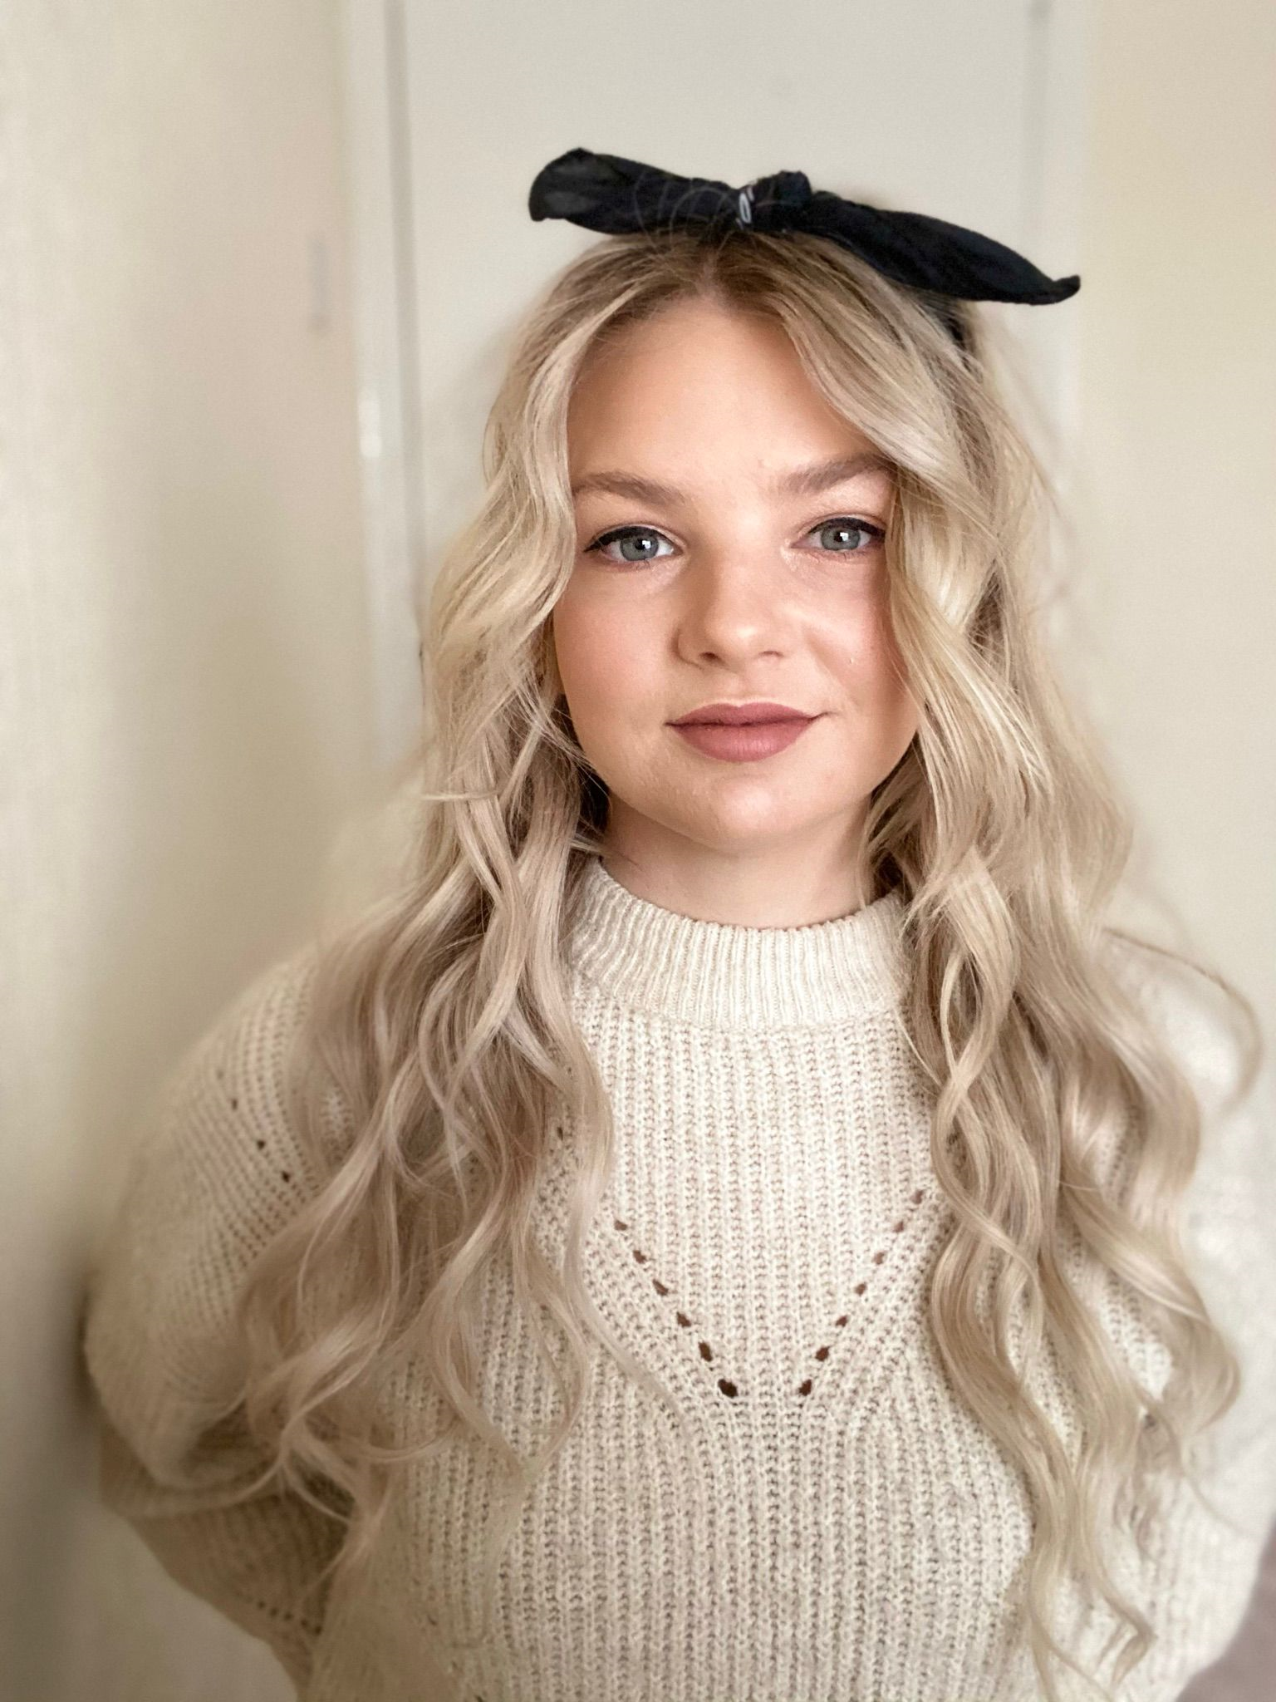
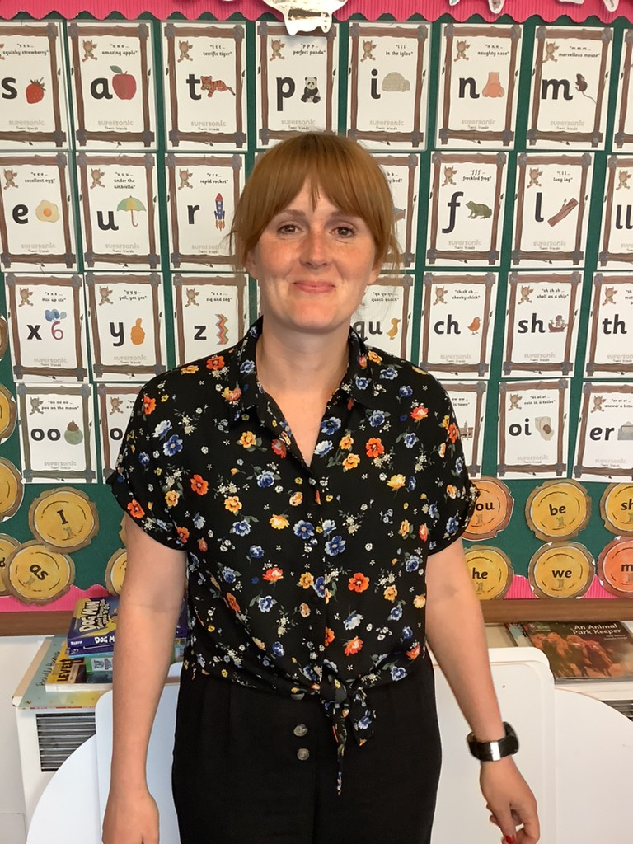
Teaching Assistants
Our teaching assistants are…
Mrs Gadsby Mrs Hogan

Slide 10
School Routines
When your child starts school they will be given a book bag that they need to bring to school every day.
Please provide a named drinks bottle that your child will bring to school every day. No fizzy or milk based drinks please.
Your child will have the opportunity to have a piece of fruit each day during the morning provided by school. If your child only likes a certain type of fruit you are welcome to provide it. We do not allow any other snacks in school.
We ask that each child has a pair of named wellies in a bag which we will use for outdoor learning over the week.
PE sessions are usually on a Friday afternoon please can your child come to school dressed in their PE kit on this day. Some of these sessions may be outside so please ensure children are dressed appropriately for the weather.

Slide 11
Independence
Please would you work with your child before they come to school so that they are as independent as they can be. It is great if they can do the following things independently when they start, although we will always be there to help them….
Put on their coat, hats and gloves.
Carry and pack their bag with their lunch box (if used) and drinks bottle.
Go to the toilet unaided and wash their hands.
PLEASE REMEMBER TO PUT NAMES ON ALL ITEMS OF CLOTHING AND SHOES

Slide 12
Thank You
Please contact Mrs Savill if you feel you need an additional meeting to support your child’s transition.
We look forward to getting to know you over the year.
.

