Slide 1

Environmental Review
2025/26
This is the editable version of the Eco-Schools Environmental Review. You can complete it by adding your answers to the slides and then saving it and uploading to your Eco-Schools’ application. This PowerPoint format enables your Eco-Committee to easily present their findings to your school community.
Give yourself a ‘Y’ for every ‘yes’ answer, an ‘N’ for every ‘no’, or leave it blank if the question is not relevant to your setting. You can do this digitally, just double-click in the centre of the corresponding circle.
To calculate your score for each topic, count the number of ‘Y’s.
At the end of every section there is a space to write down your thoughts and ideas for that topic.
Don’t worry if you have low scores on the Environmental Review, this just means you can make an even greater impact this year. Use the questions in this Review as inspiration!
Once again, thank you to everyone who submitted suggestions for this year’s Environmental Review, helping us to create the best one yet!
Completed By
Lilleshall Primary School Eco Committee

Slide 2








Biodiversity
Y/N
Do your grounds provide habitats and/or facilities to encourage insect life? For example, bug hotels, bee baths, log piles, rock piles, or leaf piles.
Y
Do your grounds provide homes and support for birds and animals? For example, bird houses, bat boxes, hedgehog highways, or bird baths.
Y
Do your grounds have bird, or other animal feeders and are they checked and topped up regularly?
Y
Do your grounds have any dedicated wildflower, meadow, wildlife corridor, or rewilding areas to support biodiversity?
Y
Are plants in your grounds chosen specifically to support biodiversity? For example, bee-friendly lavender.
Y
Do your grounds have a pond or mini-pond?
N
Do pupils have opportunities to map, observe, and record nature in your school grounds? For example, by using wildlife cameras or taking part in projects like RSPB Big Schools’ Birdwatch.
Y

Slide 3




Are there any signs or QR codes around your school that show what plants, trees, or flowers are growing, or explain how your school is helping nature and wildlife?
N
In the previous twelve months, has your school fundraised for endangered animals or conservation projects?
N
During the last year, has your school provided advice to families on supporting biodiversity at home? For example, looking for Rainforest Alliance certified products whilst shopping, or instructions for creating homemade bug hotels?
N
Total Score
6
Notes
From 2010 to 2016, the number of Mountain Gorillas grew by about 3% every year. That’s rare for wild animals, but it shows that when people work hard to protect nature, we can make a difference.

Slide 4


Energy
Y/N
Does your school have pupil energy monitors, who check that lights and other electronic devices are switched off when not in use during the daytime, and an adult member of staff responsible for checking lights and devices are turned off overnight?
Y
Do classrooms in your school have posters, signs, or a traffic light system that reminds pupils and staff to turn off electrical devices when not in use?
Y
Does your school have any renewable energy sources on site (solar panels, wind turbine, heat pump, biomass heating), or purchase energy from a renewable energy supplier?
N
In classrooms, are windows kept free of displays and radiators free from blockages to maximise natural light and heat distribution?
Y
Do pupils monitor and share information about your school’s energy use? For example, by checking a smart meter, updating an energy display, or reporting usage during assemblies.
N
In the last twelve months, has your school planned an energy-free day, energy-saving week, or something similar?
N
Did your school participate in Eco-Schools’ Cut Your Carbon Campaign, which happens throughout November each year?
N

Slide 5
Does your school encourage pupils, staff, and the wider community to reduce their digital carbon footprint? For example, by unsubscribing from unwanted emails, cleaning up inboxes, or using eco-friendly search engines.
Y
Ask your school’s site/ICT manager - do computers and the heating system in your school have automated switch off, and is this set no later than 6pm?
Y
Ask your school’s site manager - has your school building infrastructure been improved to save energy? For example, double+ glazed windows, insulation, motion-sensing lights, energy efficient lightbulbs, draft excluders etc.
Y
Total Score
6
Notes
In 2025, the UK Government said it would give solar panels to 200 schools. This is the first big project from Great British Energy. We’d love to see every school using clean, cheap solar power and this is a great first step!

Slide 6

Global Citizenship
Y/N
Has your school raised money for a charity or cause in the last twelve months, or donated to a local foodbank?
N
If you answered yes to the previous question, was any of this money raised for environmental, wildlife, or animal welfare charities?
N
Are young people allowed to take responsibility for planning fundraising events, or selecting which charities their fundraising supports?
Y
Does your school take part in any global or national campaigns like Fairtrade Fortnight or Earth Hour?
N
Does your school have links with any other schools in different countries?
Y
In the past twelve months, have any young people in your school written to their local MP about an environmental issue?
N
Does your school celebrate diversity by organising events and education around religious/cultural holidays, or celebrating events like Black History Month and Pride?
Y

Slide 7
Does your school celebrate its own diversity through displaying languages spoken in school, or organising events, celebrations, and learning opportunities that showcase the different cultures represented by pupils and staff members?
Y
Are the UN Sustainable Development Goals displayed in your school and/or included in curriculum learning?
N
Does your school canteen offer food with ethical/green labels? For example, Fairtrade, Rainforest Alliance, or Red Tractor.
N
Total Score
4
Notes
In July 2025, countries most affected by climate change won a big victory. The International Court of Justice ruled they can seek compensation for climate damage from other countries. This is a big step towards fairness and protecting our planet!

Slide 8


Healthy Living
Y/N
Does your school teach young people how to grow fruit, vegetables, and herbs?
Y
Does your school canteen use plants grown on site as ingredients?
Y
Does your school menu have plant-based options every day?
Y
Are plant-based options encouraged at lunch times? For example, are they at the top of the menu, near the start of the queue, or labelled as planet-friendly?
N
Does your school regularly have meat-free days, or promote events like Veganuary?
N
Does your school canteen have a seasonal menu?
Y
Does your school canteen work with pupils to plan healthy, planet-friendly menu items?
Y

Slide 9
Does your school discourage ultra-processed snacks and promote fresh, healthy alternatives?
Y
Does your school have a sensory garden, or other natural area, that helps pupils feel calm and relaxed whilst connecting with nature?
Y
Does your school promote mental wellbeing through events like Mental Health Awareness Week and/or by teaching exercises such as mindfulness or yoga?
Y
Total Score
8
Notes
A recent study by the Vegan Society found that 1 in 10 people in Britain are trying to eat fewer animal products. This means that more people are making sustainable food choices!

Slide 10

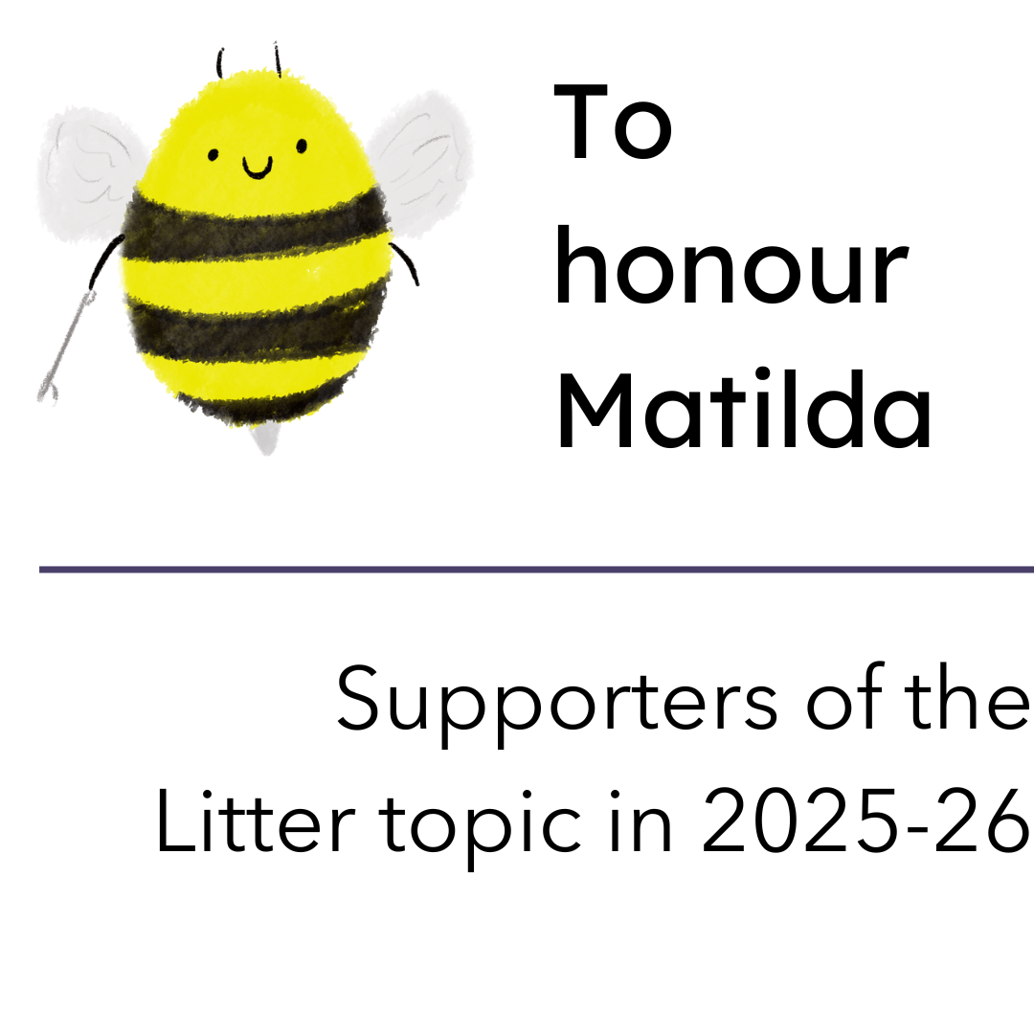
Litter
Y/N
Does your school have access to litter-picking equipment?
Y
Have pupils litter-picked in their school grounds in the last twelve months?
Y
Have pupils litter-picked in their local community in the last twelve months?
Y
Have members of your school community (e.g. families, businesses, nearby schools, council members etc.) been invited to participate in a litter-pick organised by your school in the last twelve months?
N
Does your school allow pupils to borrow litter-picking equipment to use with family members outside school hours?
Y
Does your school separate recyclable litter during litter-picks?
Y
Does your school have enough bins inside and outside the school building? No overflowing bins on site would suggest ‘Yes’.
Y

Slide 11
Have young people in your school created anti-litter posters and signs, or delivered an anti-litter assembly or campaign, in the past twelve months?
Y
Does your school have appointed Litter Monitors?
Y
Did your school participate in Keep Britain Tidy's Great Big School Clean during the last academic year?
N
Total Score
7
Notes
Did you know the UK are the current world champions in Spogomi? Spogomi is a sport from Japan where teams compete to pick up litter in public places. It was created to make cleaning up fun and now it’s a global competition!

Slide 12

Marine
Y/N
Has your school placed a ban on balloon releases and glitter?
N
Has your school taken steps to reduce laminating to help cut down on plastic waste?
Y
Has your school tried to make any of its events or celebrations plastic free?
N
Has your school organised and completed a beach, river, or canal clean in the last twelve months?
Y
Has your school created any displays, artworks, murals, or similar to raise awareness about plastic pollution?
Y
In the past twelve months, have any pupils or staff completed an audit of your school to find out what single-use plastics are commonly used on site?
Y
Does your school try to use environmentally friendly cleaning products?
Y

Slide 13
Does your school try to avoid single-use plastics in art lessons?
Y
Has your school canteen reduced its use of single-use plastics like bottles or plastic cutlery?
Y
Has your school shared ideas for plastic-free lunches with pupils or families during the last twelve months?
Y
Total Score
8
Notes
In 2027, the UK Government will start a new deposit return scheme. This means when you buy a drink in a plastic bottle, you’ll pay a small extra amount, but you get it back when you return the bottle! This will help reduce plastic pollution and encourage more recycling.

Slide 14

School Grounds
Y/N
Does your school have a tiny forest, orchard, or group of trees on site?
Y
Has your school planted trees or supported tree planting in the last twelve months?
Y
Does your school have an outdoor learning and/or eating area?
Y
Does your school have a gardening club, or does it offer gardening lessons?
N
Does your school have a greenhouse, polytunnel, or allotment area that pupils can use?
Y
Does each class/year group in your school have a designated growing area?
N
Does your school participate in No Mow May, or have an area(s) where grass isn’t cut?
Y

Slide 15
Approach three teachers (not including the Eco-Coordinator) - have all three taught a lesson outside in the past twelve months (apart from PE lessons)?
Y
Does your school avoid using pesticides and peat-based compost?
Y
Has your school shared its gardening work with the wider community (e.g. seed swaps, produce giveaways, or family gardening days)?
N
Total Score
7
Notes
Back in 2016, England’s biggest outdoor learning project found that pupils were more motivated, better behaved, and felt happier and healthier when learning outside. Teachers also said it made them feel better and helped them teach more effectively!

Slide 16

Transport
Y/N
Does your school support active travel by providing a secure, weather-protected area for storing bicycles and scooters?
Y
Does your school car park have an electric vehicle charging point, or plans to install one?
N
In the past twelve months has your school completed a walk to school week, or any other similar campaign?
Y
Does your school track how pupils and staff travel to school each day and reward pupils who travel sustainably?
Y
Does your school take part in any sustainable travel schemes like park ‘n’ stride, walking bus, Bikeability, or staff car sharing?
Y
Has your school taught pupils and/or families about the impact of engine idling near school?
Y
Does your school have a hedge, trees, or other vegetation around its boundaries to reduce air pollution in school?
Y

Slide 17
Is the road outside your school a ‘School Street,’ or has your school asked the council about making it one?
N
Do all school trips avoid airplane travel?
Y
Does your school canteen use any locally-sourced ingredients?
Y
Total Score
8
Notes
Norway is leading the world in electric cars! In 2024, 9 out of 10 new cars sold were electric. By the end of 2025, they hope all new cars sold will be electric, showing other nations that a greener future is possible.

Slide 18


Waste
Y/N
Does your school recycle any difficult-to-recycle items like batteries, pens, printer cartridges, or crisp packets?
Y
Is your school's food and brown waste composted and, when possible, is this compost used in the school grounds?
N
In the past twelve months has your school hosted any second-hand sales or swap events e.g., clothing, books, revision guides?
N
Does your school collect and redistribute preloved uniform?
Y
Does your school use any refillable products (for example, whiteboard markers, glue sticks, or soap dispensers) or do you sell any refillable products?
Y
Are recycling bins clearly labelled with signs or posters showing what can and can’t be recycled in school?
Y
Spot-check three recycling bins in your school. Do all three have the correct items in?
Y

Slide 19
Does your school use recycled paper products like printer paper or toilet paper?
Y
Has your school introduced measures to reduce its use of paper? This might be through printing on both sides, sending letters/homework electronically, adding a release code to the photocopier, limiting use of worksheets, or continuing to use exercise books across academic years.
Y
Ask your school’s canteen staff whether they have taken any action to reduce food waste in the last 12 months? For example, sharing data with pupils, a pre-order system, or offering smaller portion sizes.
Y
Total Score
8
Notes
More people are choosing pre-loved clothes! By the end of 2025, second-hand clothing is expected to make up 1 in 10 sales in the global fashion market. This shows how everyday choices, like what we wear, can help build a more sustainable future.

Slide 20


Water
Y/N
Does your school have a water-butt?
Y
Does your school use water-saving devices like reduced flush toilets, tap inserts, or sensor taps?
Y
Does your school have a water bottle refill station that pupils can use?
Y
Do your school toilets have posters reminding people to turn off the taps?
Y
Has your school shared water-saving tips with pupils or families (e.g. in newsletters or assemblies)?
Y
In the past twelve months, has your school supported water charities or taken part in events like World Water Day?
N
Have Water Monitors helped check for leaks with the site manager in the last six months?
Y

Slide 21
Do toilets in your school have hand dryers instead of paper towels?
Y
Choose a class to survey - do most of the class have a reusable water bottle in school with them at the time of survey?
Y
Are reusable water bottles taken on school trips?
Y
Total Score
9
Notes
Parts of the River Thames were once ‘biologically dead’, but now they’re full of life again, with over 100 types of fish and nearly 100 birds. Thanks to groups like Thames21, who’ve removed nearly 150,000 wet wipes since 2017, the river is making a comeback!

Slide 22

Other
Y/N
Has your school used Count Your Carbon to calculate its carbon footprint in the last twelve months?
N
Ask your headteacher - does your school have a Climate Action Plan?
Y
Has your school hosted an environmental visitor or taken part in an eco-themed trip in the last twelve months?
Y
Have pupils in your school planned and delivered an environmentally-themed assembly in the previous twelve months?
Y
Does your school share its environmental achievements online or in newsletters to inspire others?
Y
Is your school part of a Green Network and/or has it worked with any other schools on an environmental project in the previous twelve months?
N
Does your school run an annual event focused on environmental awareness, such as a themed day or week of learning?
N

Slide 23
Does your school library have a section for environmental books?
N
Has your school worked with the council or a local group on an environmental project in the last year?
Y
Does your school’s reward system recognise environmental action and achievements?
Y
Total Score
6
Notes
You’re not alone in making a difference! In 2025, the Eco-Schools programme was running in 101 countries, with almost 14 million young people taking action to help the planet. Together, you're part of a global movement for change!

Slide 24
Our Results
Total Score
83
Positives
Healthy Living
Litter
Marine
Transport
Water
Waste
Negatives
Global Citezenship
Notes

