Slide 1

Writing Workshop EYFS
Vanessa Savill – Spring Term 2024
This Photo by Unknown Author is licensed under CC BY-SA-NC

Slide 2

Teaching writing in EYFS
What knowledge and skills do we need to write independently?
How to hold a pencil correctly.
Say an appropriate word or sentence to write clearly with correct pronunciation.
Use the phonic skills to segment the word for spelling.
Know what the letters look like in order to write them.
Learn sentence punctuation.
Concentrate for long enough to bring all this knowledge and skill together in our working memory in order to write.

Slide 3
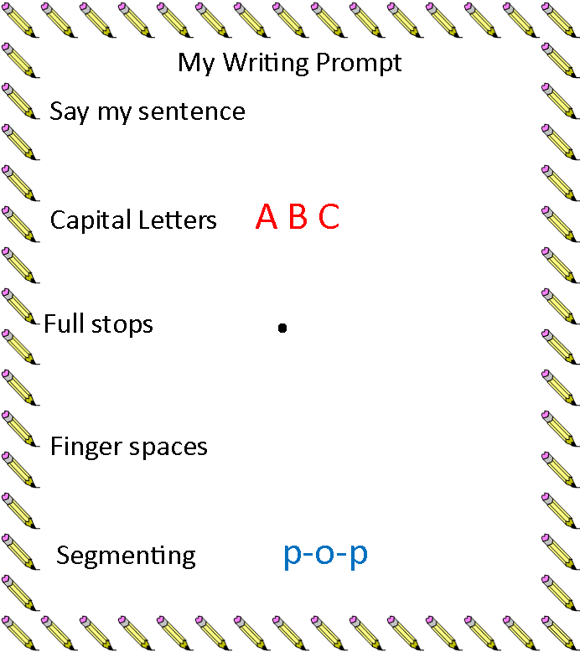
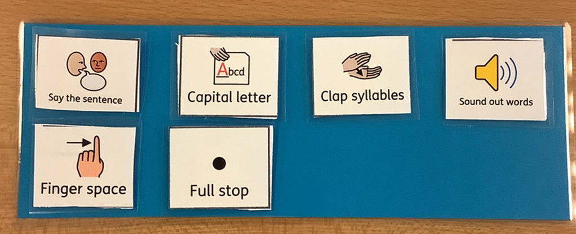
How we teach the process of writing
First, we decide on the sentence we need to write.
Sing the sentence song.
We say the sentence aloud.
Say the sentence aloud and use my fingers to show each word.
Say it again and add in finger spaces.
Check pencil grip and posture.
Say first word, segment first word, write first word. Check position on the page.
Finger space, next word and so on until full stop.

Slide 4
Segmenting Words
We write in line with our latest phonics teaching:
All the tricky words we have already taught we expect to see spelt correctly.
All the sounds and digraphs we have taught we expect to see in place.
The children will need to ‘hulk smash’ the word before they write.
Always praise first and then say - Can I tell you something that will make your writing even better?
If it is a two syllable or multi syllable word we clap the syllables first and then segment each syllable at a time and write each part in turn.

Slide 5
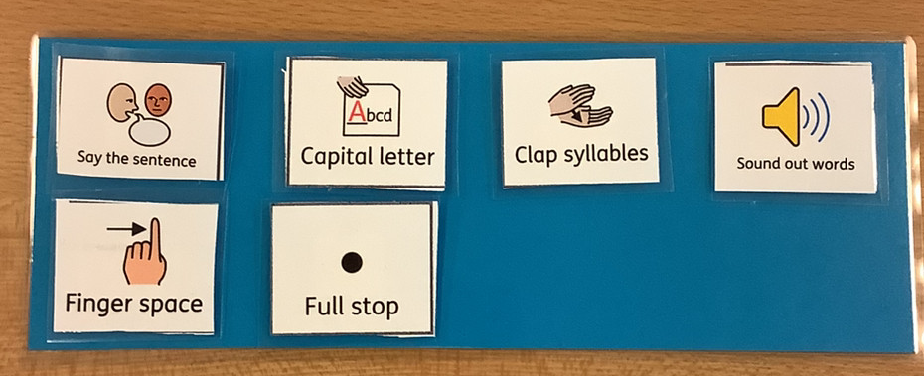
After each sentence is written…
Use the sentence prompt to check you have everything a sentence needs.
Make sure that there are no words missing and it makes sense.
Practise anything that needs to be improved.
Do all letters with ascenders and descenders have them?
Correct reversals
Correct tricky words that are mis-spelt.
Model the sentence for them so they can see how it looks.

Slide 6
When should I encourage writing?
Some children will enjoy writing and want to do it all the time – Let them!
Some children will never, ever ask to write at home – here’s how to help:
If they draw a picture ask them to label it.
Encourage them to work alongside you if you are writing a list or a note for a family member. Ask as if you would like their help.
Use writing as part of play. When you are playing alongside them – write as part of the game – label the lego, write a doctors note, leave a note on the ipad to tell someone to leave the game alone, have a secret code to get inside the den they’ve made.
Provide exciting writing tools and paper, post it notes are very popular.

Slide 7
Try to / Try Not To…
Try to:
Rephrase a very tricky sentence to something more simple – It is a….. / I went to…. / I got a……
Praise for effort, good segmenting, careful handwriting, great determination, meeting a challenge.
Have the resources children need to hand – sound mat / tricky word mat / sentence prompt – all found on the website.
Try Not To:
Write words for children to copy. This is handwriting practice not writing.
Give the children the sounds when they ask you to spell something. Use hulk smash to segment with them.

Slide 8
When a child is struggling…
As teachers we need to identify which parts of the writing process children are finding difficult. It could be one or more of the following areas:
Physical – children unable to form letters clearly enough to read what they have written.
Phonics – children have insufficient knowledge of phonemes / graphemes to enable them to write a sentence independently.
Executive function and working memory barriers – children are unable to hold all the knowledge they need in order to concentrate, segment, form letters and follow features of a sentence at the same time.
SEND – children have specific learning difficulties related to literacy / communication and language including - speech and language / vocabulary / grammar difficulties.

Slide 9
Intervention
Once identified:
Children need additional work in the area that they are finding difficult
Pre teach and intervention through practise of segmenting for spelling
Handwriting activities – gross and fine motor activities – dough disco.
Executive Function activities – see sheet on website.
Practise makes permanent!

