Slide 1
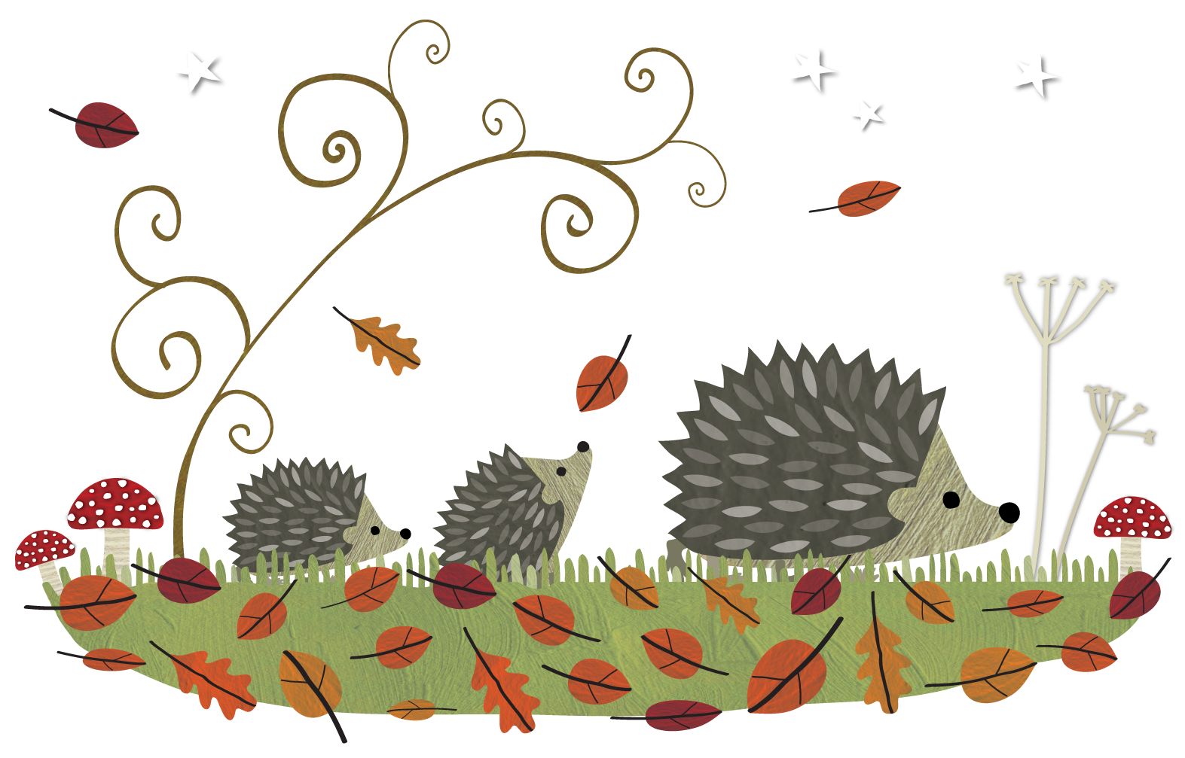
Good morning everyone and welcome to our assembly all about…
HEDGEHOGS
© The Future is Unmown

Slide 2
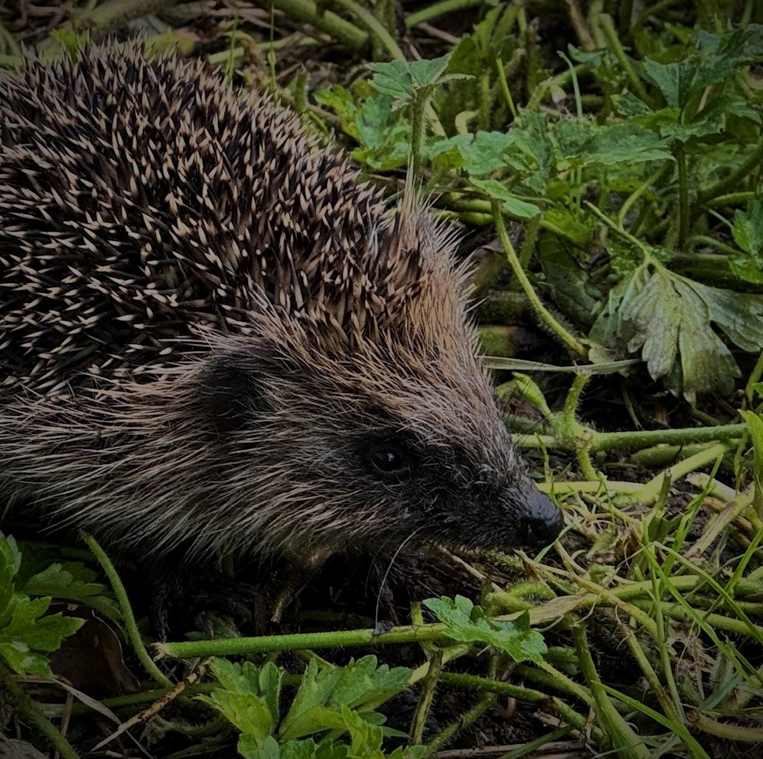
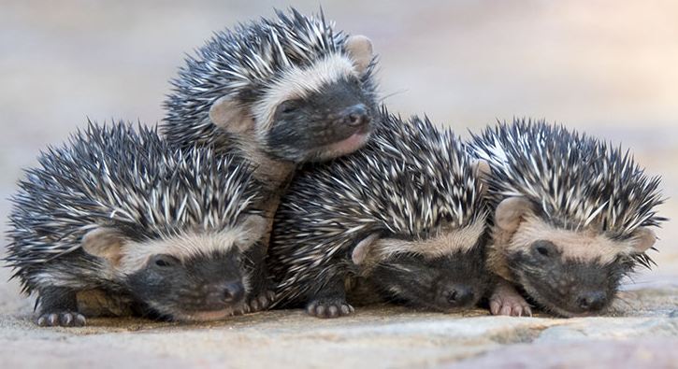

Let’s talk about hedgehogs…
Hedgehogs are small, spiny mammals. This means they:
  Are warm-blooded
  Have a backbone
  Have hair or fur
  Produce milk
  Have live young (called hoglets!)
© Michael Wilkinson / BHPS

Slide 3
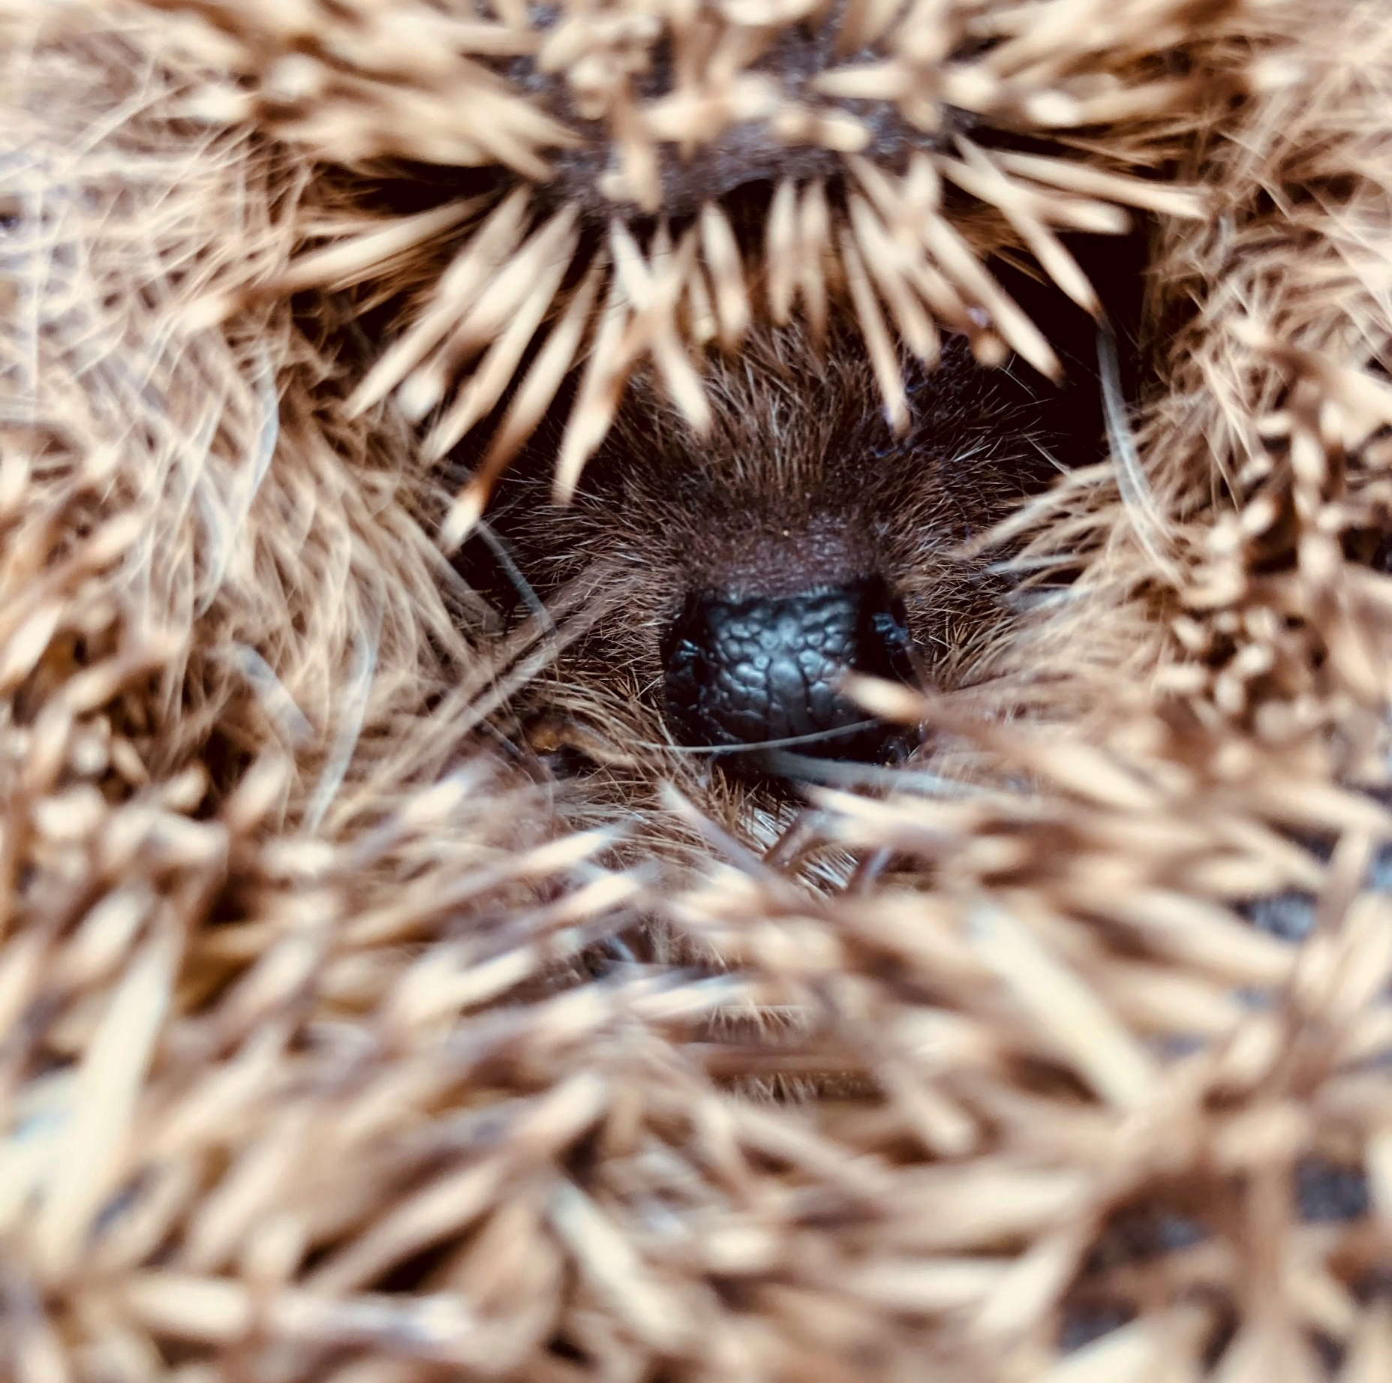
More about hedgehogs…
They are NOCTURNAL. This means they sleep during the day and only come out at night.
They don’t run from danger or try to attack – they roll into a tight spiky ball to protect themselves!
Their favourite foods are bugs, grubs and beetles!
© Claire Grey/ BHPS

Slide 4
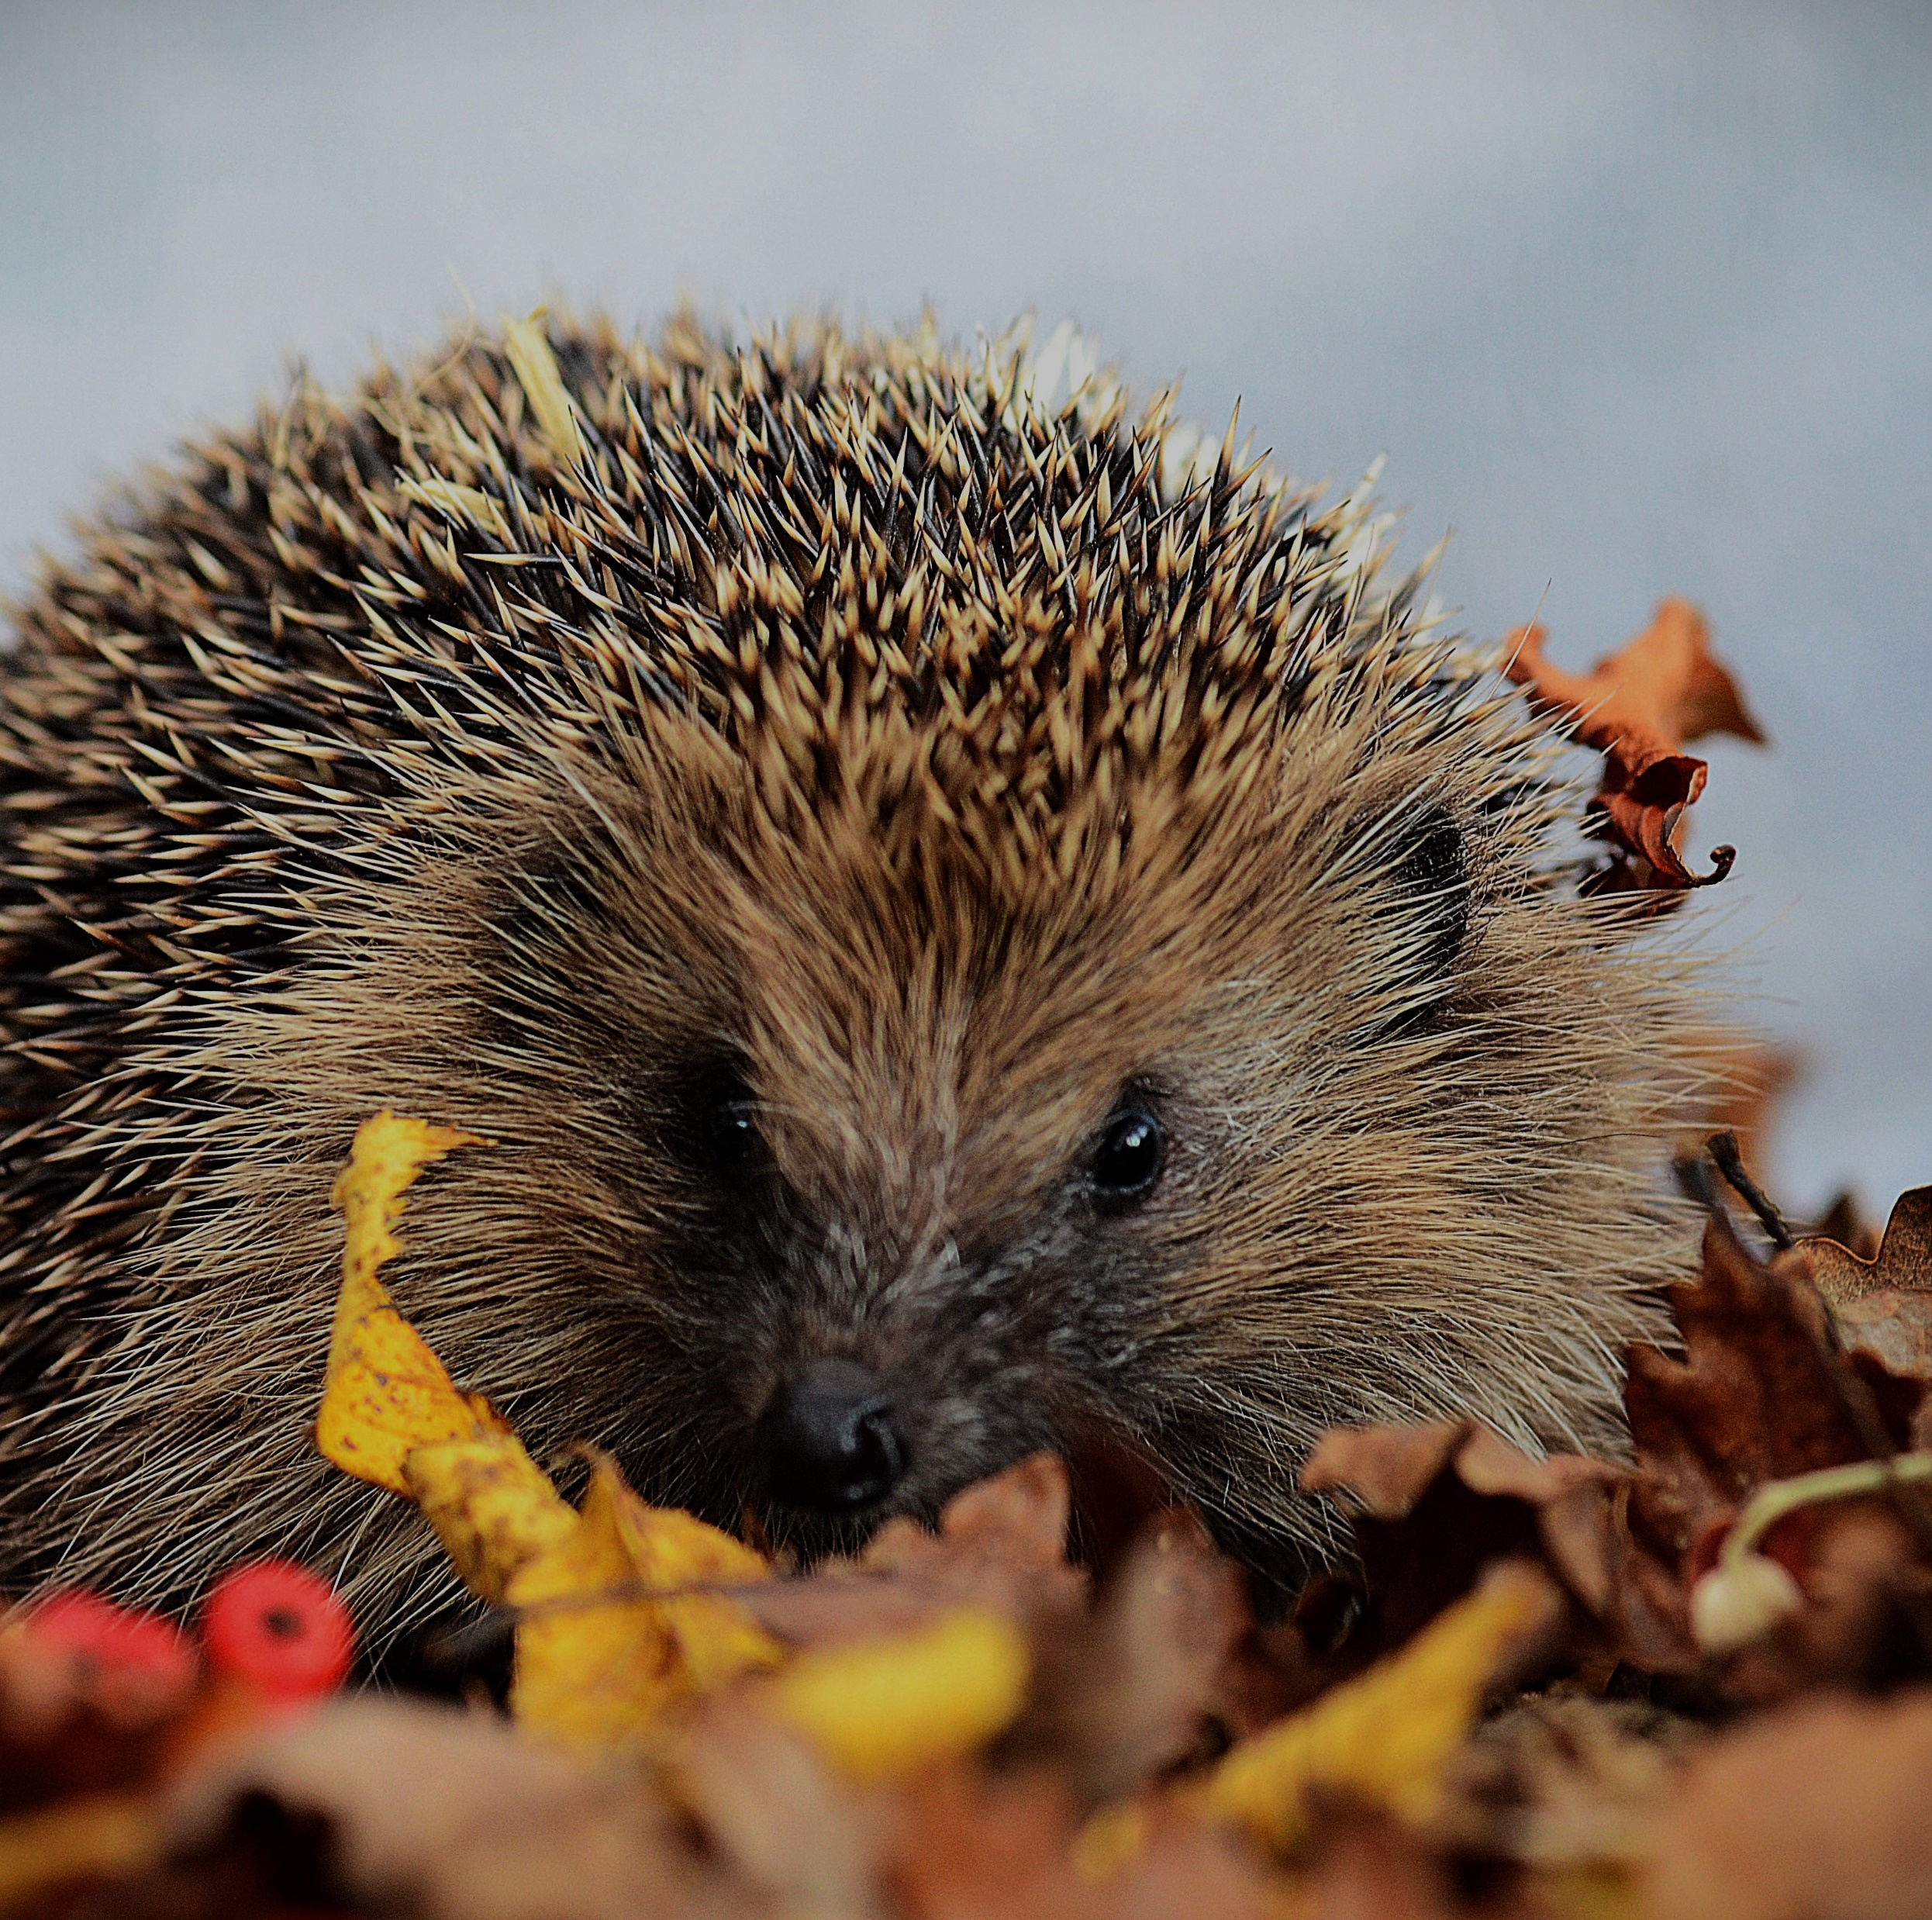
Hibernation
Even more about hedgehogs…
When it gets cold and there isn't much food around...
Hedgehogs hibernate!
This means that they make a cosy winter nest, curl up into a tight spiky ball and enter a deep sleep until the weather warms up again!
© Sue Ellis / BHPS

Slide 5
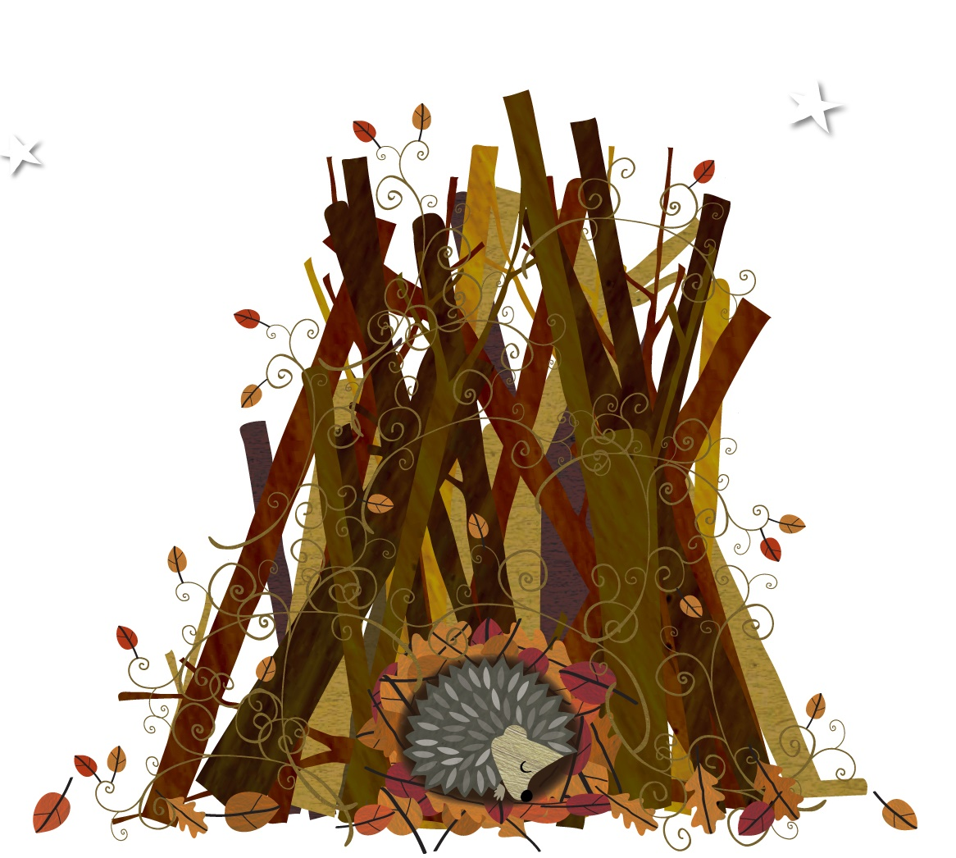
…especially around 5th November & Bonfire night!
RememberHedgehogs
Bonfire piles look like 5-star hotels to hedgehogs looking for a safe and cosy winter nest to hibernate in – so it’s vital to…
Stop! Move! Check! and think of wildlife!
© The Future is Unmown /BHPS

Slide 6
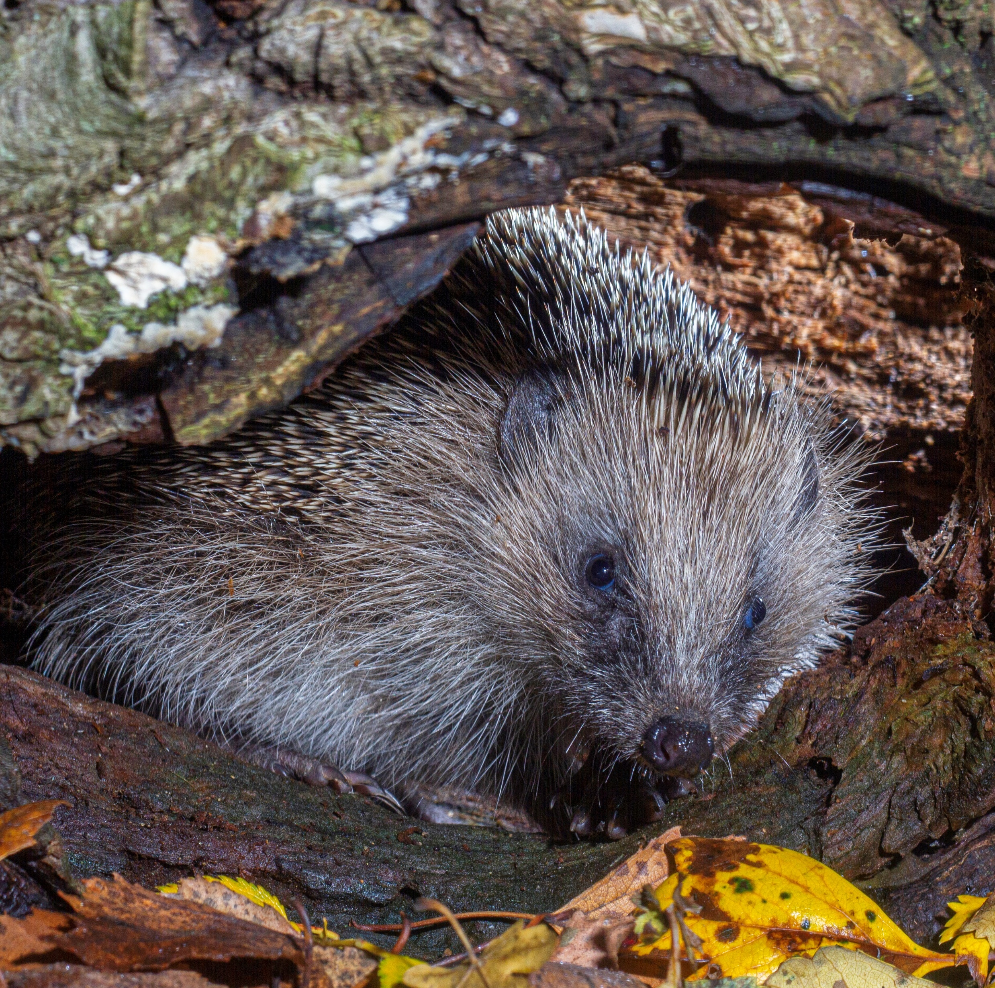
STOP! MOVE! CHECK!
Stop – do you need to have a bonfire this year? Can you attend a community event, or do something else fun instead?
Move – if your family does decide to have a bonfire, make sure they build it on the day it’s going to be lit. Move all the materials to a new site if they’ve been piled up overnight as hedgehogs may be nesting inside!
Check - Get an adult to check the pile carefully for wildlife and other animals before they light it.
© Colin Barley / BHPS

Slide 7
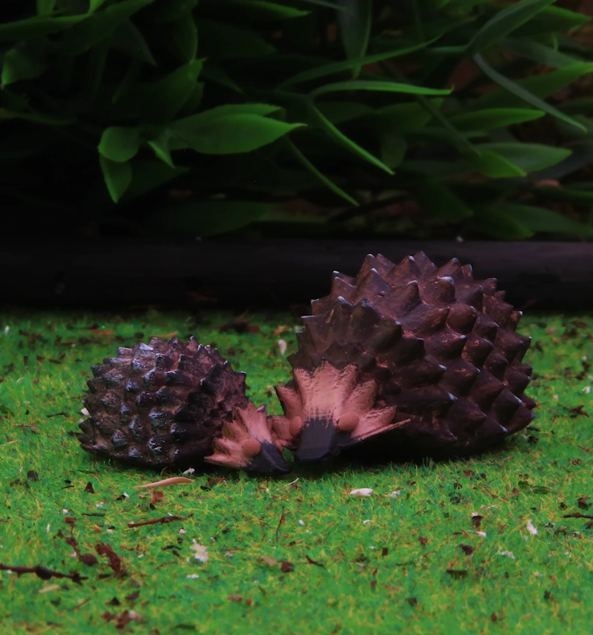
Help the Littlest Hoglet
Watch The Littlest Hoglet
…to know how you can help to protect the hedgehog population.
© BHPS / Liquona

Slide 8
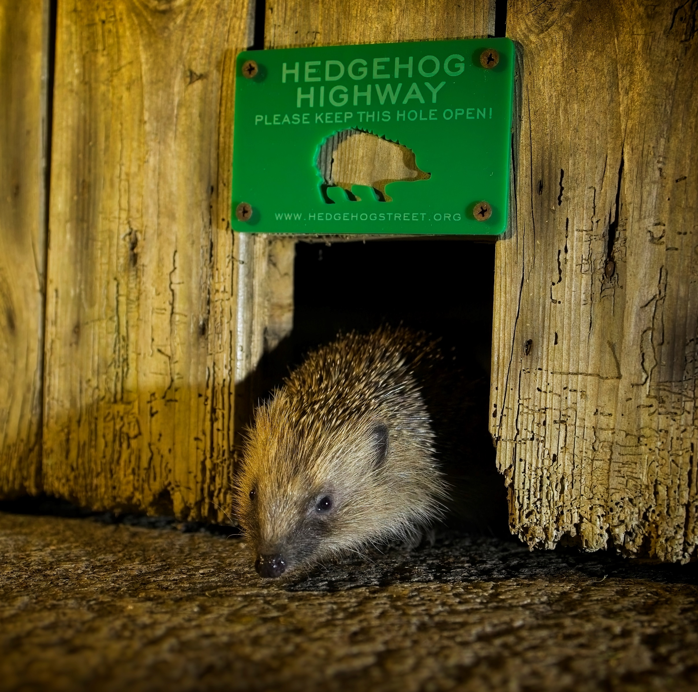
Hedgehog Highways
How do you get into your school?
How do you think a hedgehog might get in?
Have a look around your school’s outside areas:
  Is your school surrounded by a big fence or a wall?
  Are there any gaps for hedgehogs? You could use a ruler to see if they are big enough! Remember hedgehogs need 13x13cm square holes to get in.
© Christopher Morgan / Hedgehog Street

Slide 9
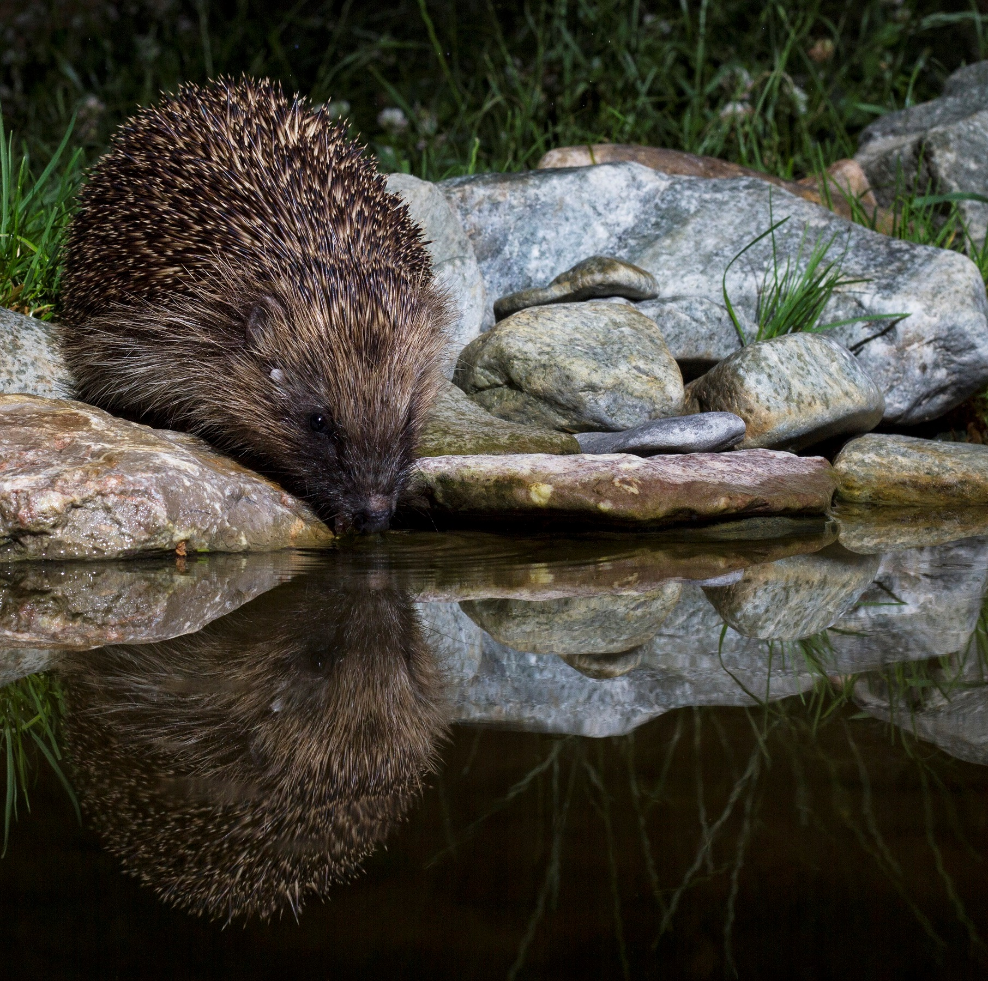
Steep Sided Pond
Why might a hedgehog visit your school?
Have a look around your school’s outside areas:
  - Have you seen any yummy bugs that a hedgehog might eat?
  - Could your school create a wildlife garden? If you already have one, could you design a sign to tell hedgehogs where they can find their favourite food?
  - If you are lucky enough to have a school pond, does it have a wildlife ramp?
© Colin Barley / BHPS

Slide 10
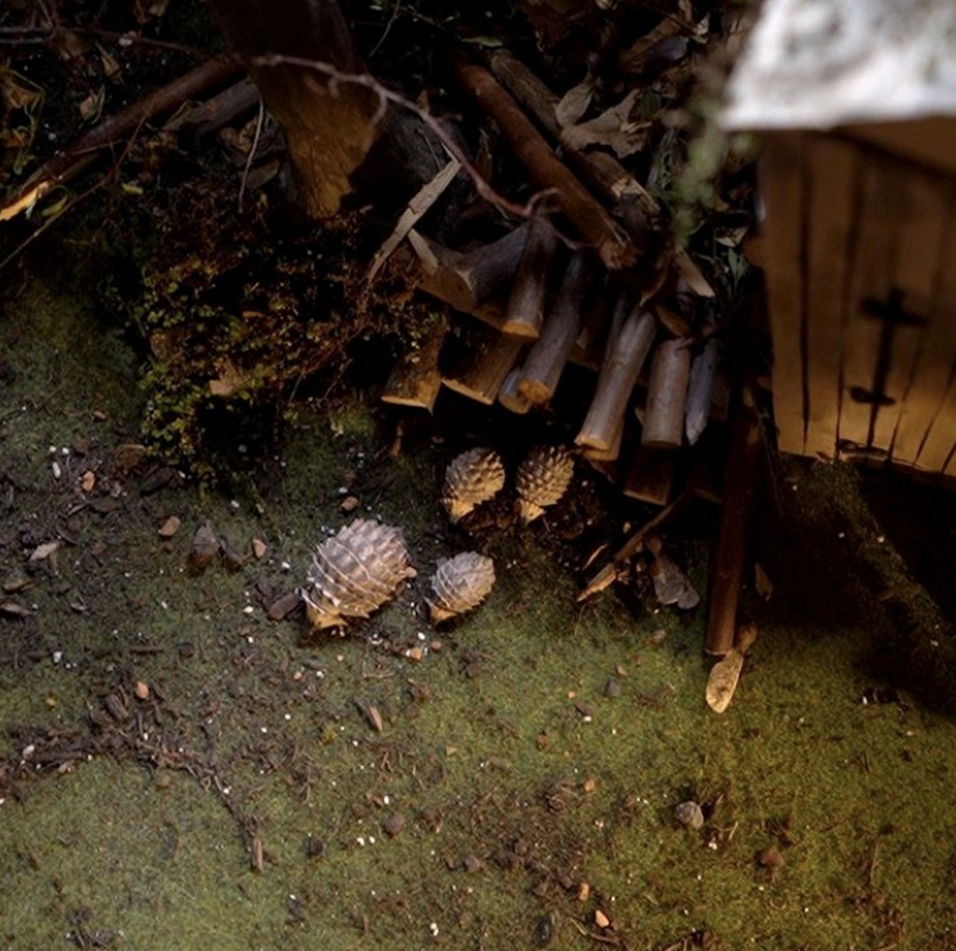
The Log Pile
Where could a hedgehog hide at your school?
Have a look around your school’s outside areas:
  Do you have any bushes, flowers or overgrown areas that a hedgehog could hide in?
  Could your school create a wildlife garden? If you already have one, could you design a hiding place for The Littlest Hoglet?
  Can you design the perfect hedgehog house? Maybe you could recycle materials from around your school to actually build it?
© BHPS / Liquona

Slide 11
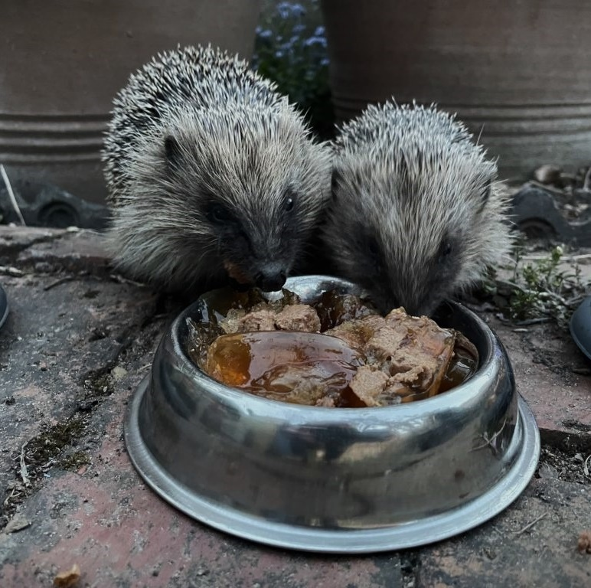
The Free Meal
Have you seen any litter around your school?
Take a look around your school’s outside area:
  If you see any litter pick it up, ask your teacher about organising a litter pick!
  Make sure you put all your litter in the bin.
  Can you draw a sign to tell others not to drop litter? You could even draw The Littlest Hoglet!
© Adrienne Grove / Hedgehog Street

Slide 12
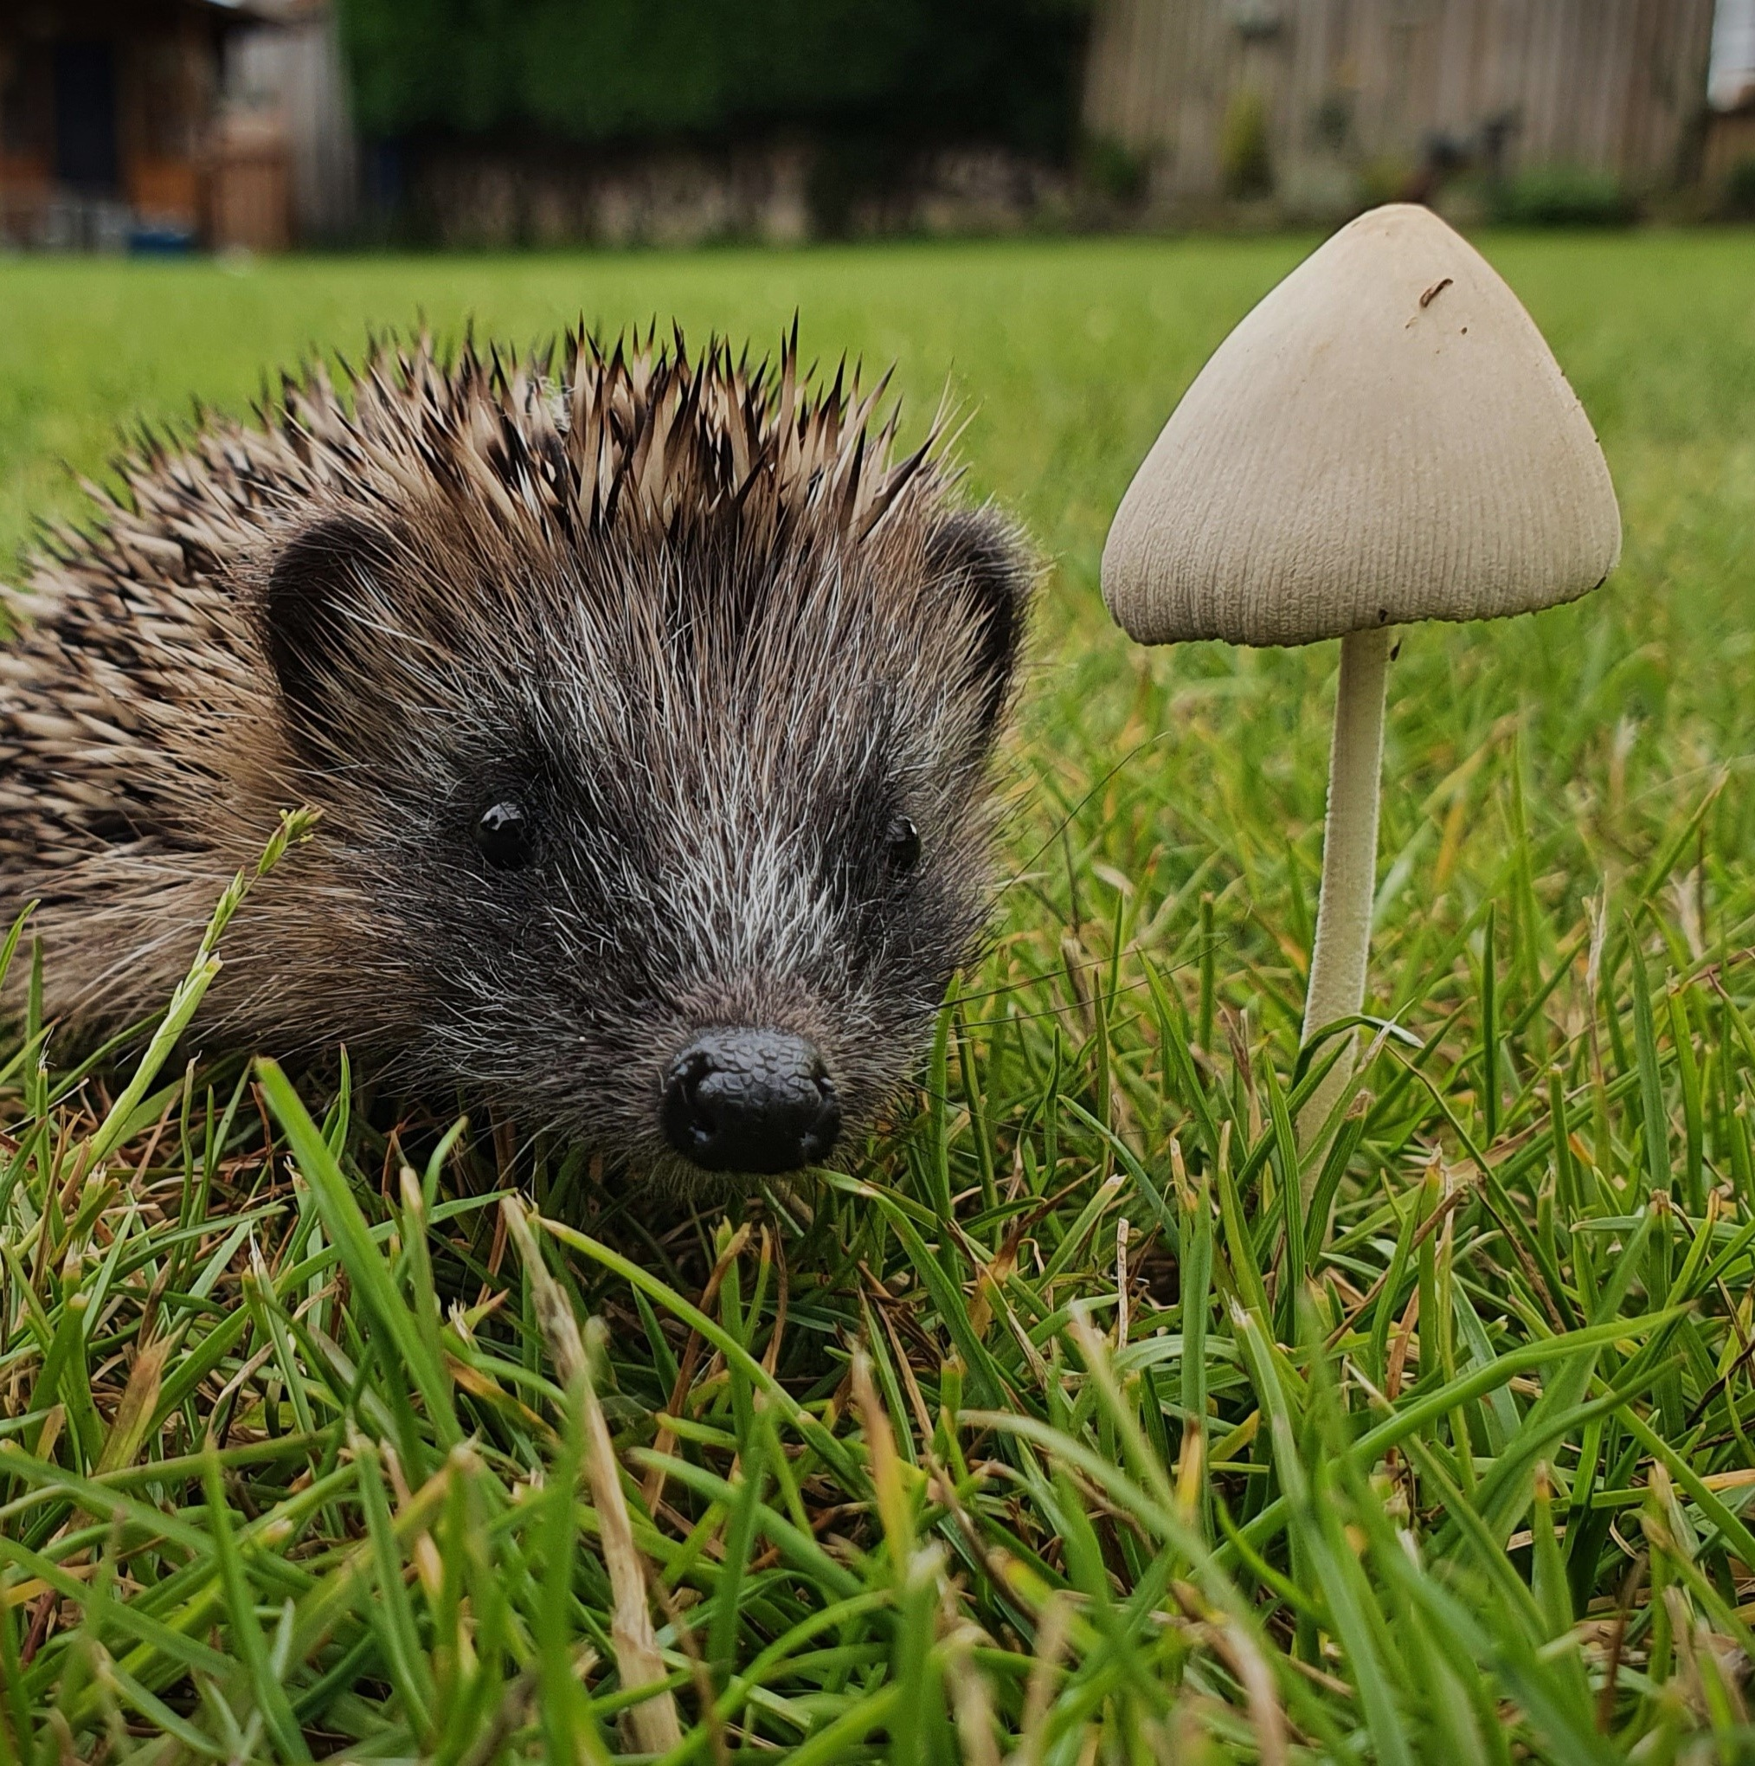
A Close Shave
Do you have grass at your school to play on?
Does someone cut that grass?
  Could you make a sign to warn them to watch out for The Littlest Hoglet?
  When you are at home always check the grass before you cut it.
© Elaine Snowdon/ BHPS

Slide 13
So what next?
The Eco-Committee are going to carry out an audit of the school grounds to see how hedgehog friendly we are.
We are going to make an open compost bin to provide food and shelter for hedgehogs.
If you see anything around school that could be improved or have any other suggestions, please speak to a member of the Eco-Committee.
© Elaine Snowdon/ BHPS

